Slide 1

Sprt1 : Project Management Platform
Group 3
Jan | 2023

Slide 2




Contents
Introduction
Domain Model Diagram
Conceptual Classes Cat List
Glossary
Use Case Diagram
US001 – US006
Class Diagram

Slide 3

Domain Model Diagram
Introduction

Slide 4
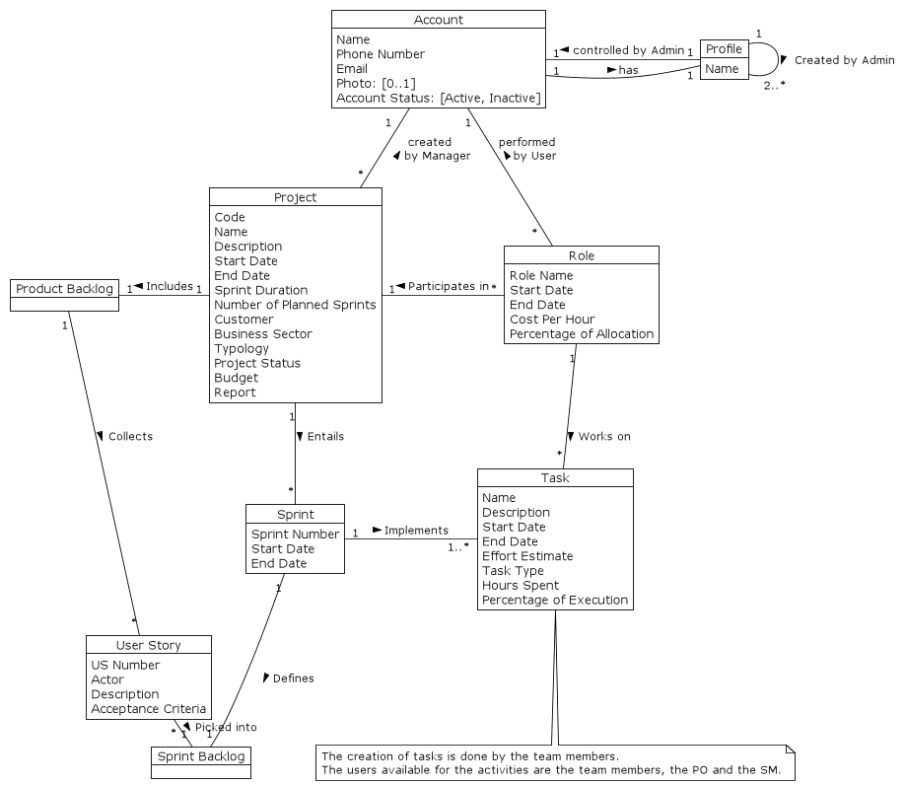

Slide 5
Conceptual Classes Category List
Introduction

Slide 6
Category | Candidate Classes
Products/Services | ProjectManagement
Roles | Administrator, Manager, User; ProjectManager, ProductOwner, ScrumMaster, TeamMember; ProjectUser
Places | System/Platform
Noteworthy Events | UserRegistration, ProfileChange, AccountActivation, AccountInactivation, UserAllocation, SprintCeremonies, Sprint
Descriptions of things | ProductBacklog, ProjectTypology, TaskType
Containers of things | AccountList, ProfileList, Roles, UserStory, ProductBacklog, SprintBacklog, ProjectTimeline, Project
Elements in containers | User, Task, UserStory
Other (external) Systems | LegacyPlatform
Records of Finance, work, etc | Budget
Documents/Files mentioned | AllocationReport, KPIReport, LogFile
Performance tools | BurndownChart, SchedulePerformanceIndex, CostPerformanceIndex

Slide 7
Glossary
Introduction

Slide 8
Term (EN) | Term (PT) | Description
Account | Conta de Utilizador | Information that represents a person in the system.
Activity | Atividade | The same as Task.
Administrator Profile | Administrador, perfil de | Profile responsible for registering and managing Accounts and creating Profiles, associate Accounts to Profiles and general system configurations. When the system is installed, an Account with this Profile is automatically registed.
Allocation Report | Relatório de Alocação | Report containing information about the Projects to which each Resource is assigned at each time.
Burndown Chart |  | Graphical representation of the Tasks left to do in a Sprint vs time.
Credentials | Credenciais | Information required for a person to access the system, email and password.
Cost Performance Index (CPI) |  | A measure of cost-effectiveness in a Project. It represents the amount of work done per unit of cost spent.
Gantt format | Gantt, Formato de | A type of bar chart that illustrates a project schedule.
Key Performance Indicator (KPI) |  | The critical quantifiable indicators of progress toward an intended result.
KPI Report | Relatório KPI | Report made available to a Manager, Project Manager and Product Owner displaying information relating to the performance of the Project, including SPI and CPI.
Log File |  | File containing a record of user operations and/or system messages. Can be of levels {"debug", "info", "warn", "error"}.
Manager Profile | Gestor, perfil de | Profile that allows access to all Projects and manage Resources. Does not participate in Projects.
Product Backlog |  | The ordered set (by priority) of all User Stories to be implemented in a Project. Created by the Product Owner of the Project.
Product Backlog Grooming |  | Decomposition of a broad User Story into several more detailed User Stories. Only done by the Product Owner on the User Stories in the Product Backlog.
Product Owner (PO) |  | A Role that can be associated to an Account within a Project over a certain time period. Creates User Stories and selects which to include in a Sprint Backlog with the Team Members.
Profile | Perfil | Attribute of an Account that limits which functionalities it has access to. One of {Administrator, Manager, User}.
Project | Projeto | Concerted effort with a set goal. The base entity to associate Activities and Resources.

Slide 9
Term (EN) | Term (PT) | Description
Project Manager (PM) | Gestor de Projeto | A Role that can be associated to an Account within a Project over a certain time period. Manages the Project, and edits part of the Project information in the system. Does not participate in Tasks.
Project Registration | Registo de Projeto | The creation of a Project, done by a Manager.
Project Timeline |  | Planned time period for a Project. Divided into Sprints.
Report | Relatório | Document containing information relating to a Project.
Resource | Recurso | Any Account with a User Profile, representing a person that contributes to a Project.
Role | Papel | Attribute of an Account with a User Profile within a Project. One of {Project Manager, Product Owner, Scrum Master, Team Member}.
Scrum Ceremony |  | Event in a Scrum managed Project. One of {Sprint Planning, Sprint Review, Sprint Retrospective}.
Scrum Master (SM) |  | A Role that can be associated to an Account with a User Profile within a Project over a certain time period. Responsible for the Scrum Ceremonies.
Schedule Performance Index (SPI) |  | A measure of how close the Project is to being completed compared to the schedule.
Session | Sessão | Functionality that allows an Account to be automatically identified in several requests after a first successful authentication.
Sprint |  | Time unit into which a Project Timeline is divided (multiple of weeks). During this period the project team, PO and SM do not change.
Sprint Backlog |  | Set of User Stories to be addressed during a Sprint.
Status | Estado | Attribute of an Account. One of {Active, Inactive}.
Task | Tarefa | An activity that has to be done in order to complete a User Story. Done by Team Members.
Team Member | Membro de Equipa | A Role that can be associated to an Account with a User Profile within a Project during a period of time.
User Profile | Perfil | Default Profile of an Account. Allows the User to perform Tasks and be attributed Roles in Projects.
User Registration | Registo de Utilizador | The creation of an Account, done by an Administrator.
User Story |  | A way of expressing the requirements of a Project.

Slide 10
Use Case Diagram
Introduction

Slide 11
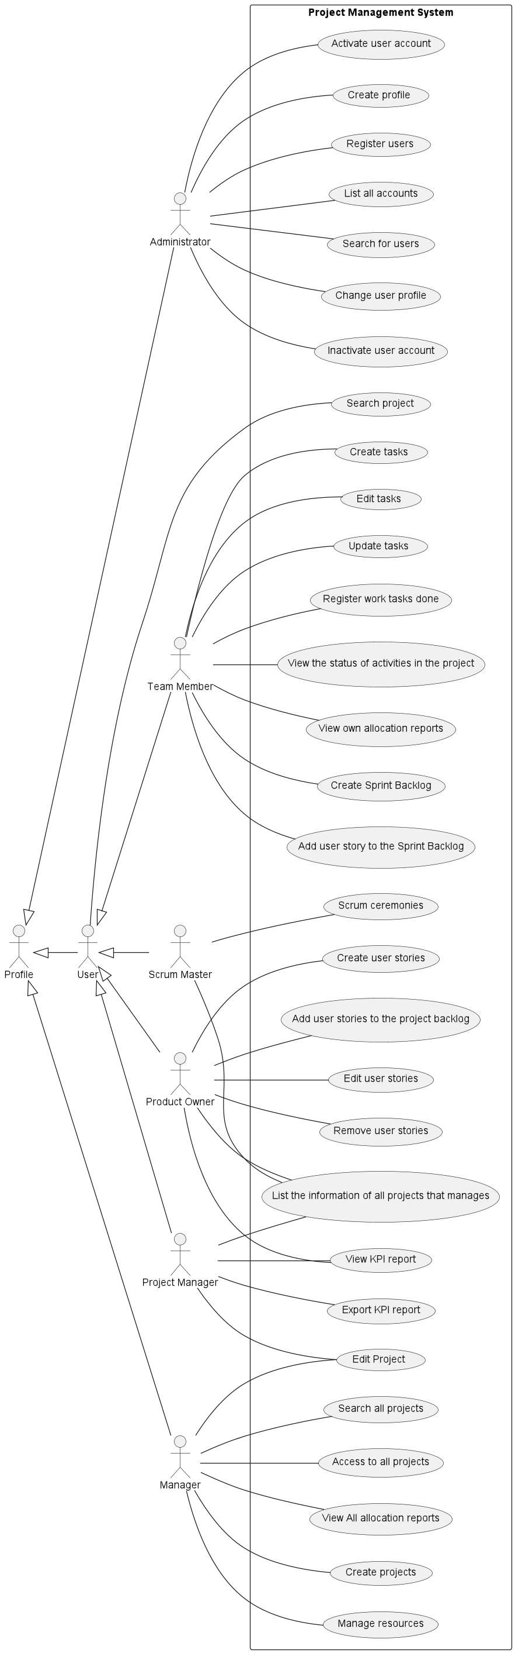

Slide 13
User Story 1
As Administrator,
I want to create user profiles

Slide 14
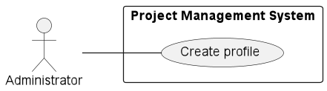
US001 : Use Case Diagram

Slide 15
US001 : Requirements Engineering
1.1 – User Story Description
As Administrator, I want to create user profiles.
1.2 – Customer Specifications and Clarifications
From the specifications document:
"Administrator profile is available when the system is installed (an account with this profile should be automatically created with installation)";
"Configuration of profiles associated with users is available to the administrator, in order to restrict access to features. Each profile will have permissions associated with available actions and functionalities".
From the client clarifications:
Question: Should the administrator be able to configure other profiles (besides Administrator, Manager and User)?
Answer: “For now, only those three. In the future, other profiles may appear”.
Question: Is there only one Administrator, or can several users be assigned this profile?
Answer: “There’s no reason to restrict it to one user. But it’s irrelevant”.

Slide 16
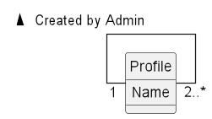
US001 : Domain Model Diagram

Slide 17
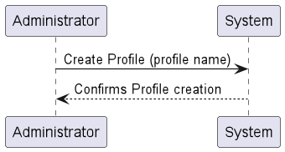
US001 : System Sequence Diagram

Slide 18
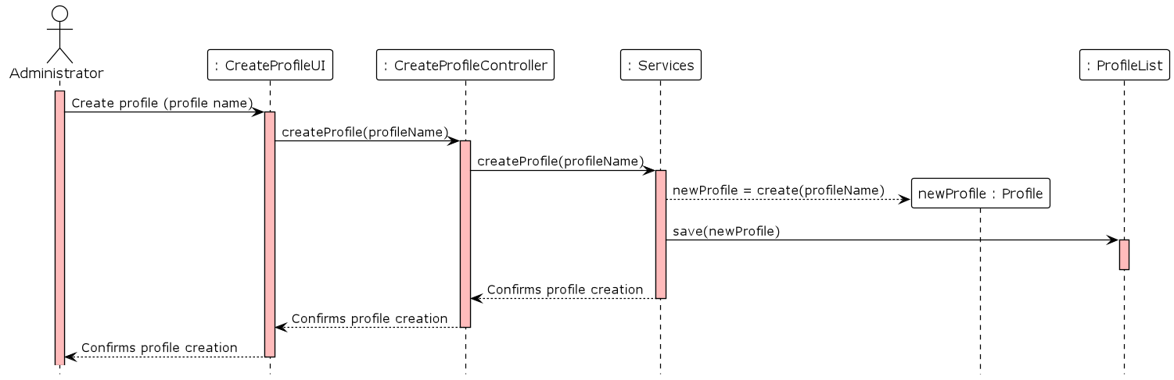
US001 : Sequence Diagram

Slide 19
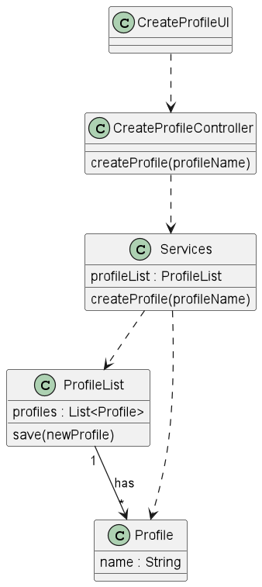
US001 : Class Diagram

Slide 20
User Story 2
As Administrator,
I want to register a user

Slide 21
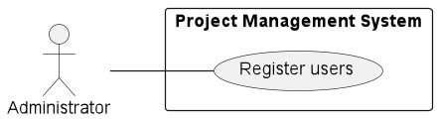
US002 : Use Case Diagram

Slide 22
US002 : Requirements Engineering
1.1 – User Story Description
As Administrator, I want to to register a user.
1.2 – Customer Specifications and Clarifications
From the specifications document:
The system should make it possible for the Administrator to register users through a form accessible via a link in the login
zone. Each user's registration must request at least the following information: “Name”, “E-mail”, “Phone number”, “Photo
(optional)”. The user is automatically associated with the “User” profile.
From the client clarifications:
Question: Are there restrictions to consider a username valid (e.g., minimum number of characters)? Must the user provide their First and Last name in separate fields?
Question: From which countries do you accept registrations? (which phone number formats are valid?)
Question: Should there exist a default photo for users that do not want to upload a photo on their profile?

Slide 23
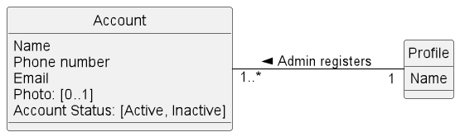
US002 : Domain Model Diagram

Slide 24
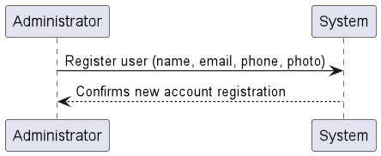
US002 : System Sequence Diagram

Slide 25
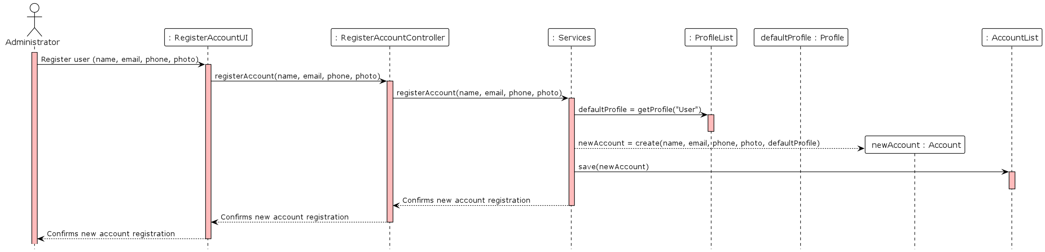
US002 : Sequence Diagram

Slide 26
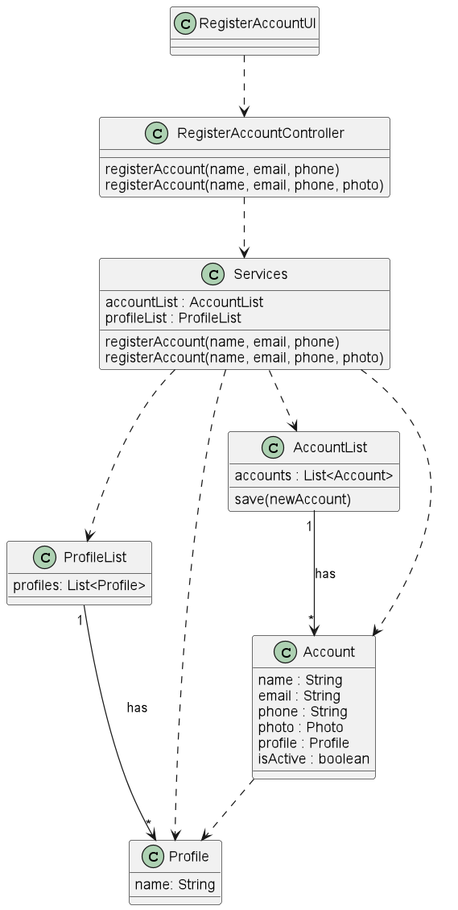
US002 : Class Diagram

Slide 27
User Story 3
As Administrator, I want to
change the profile of a user account

Slide 28
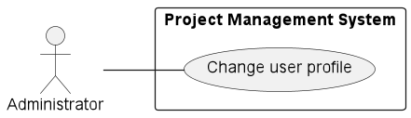
US003 : Use Case Diagram

Slide 29
US003 : Requirements Engineering
1.1 – User Story Description
As Administrator, I want to change the profile of a user account.
1.2 – Customer Specifications and Clarifications
From the specifications document:
"The system should have an administration area, which allows the Administrator to […] Associate user accounts with existing profiles[…]".
From the client clarifications:
Question: Is it possible to associate the “Administrator profile” to any other user account?
Answer: Yes, see US001.
Question: Should it be possible to perform any further alterations to the user account besides switching the profile?

Slide 30
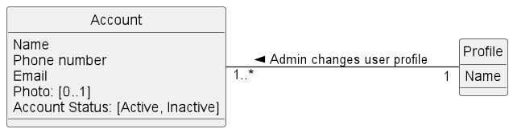
US003 : Domain Model Diagram

Slide 31
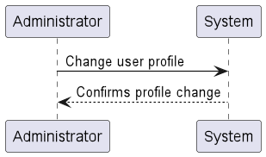
US003 : System Sequence Diagram

Slide 32
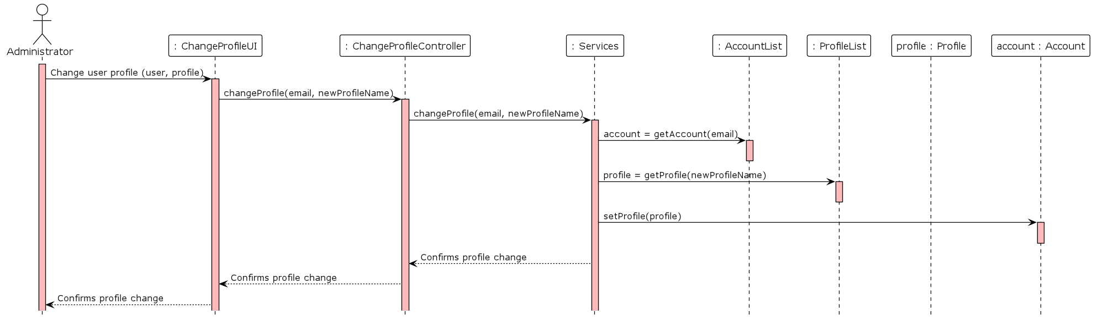
US003 : Sequence Diagram

Slide 33
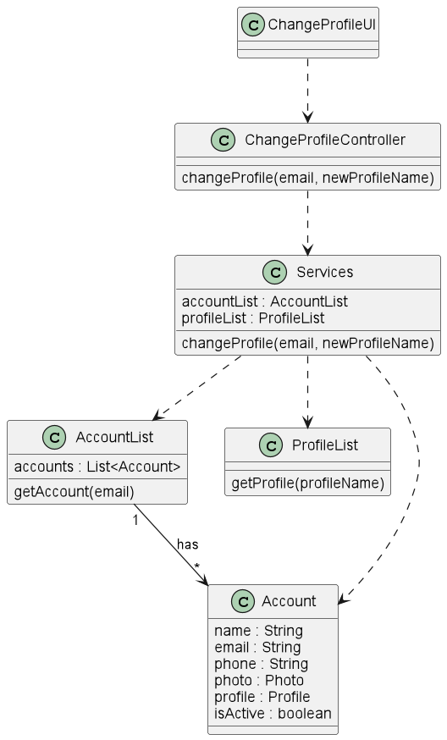
US003 : Class Diagram

Slide 34
User Story 4
As Administrator, I want to get a list of
all user accounts and their status

Slide 35
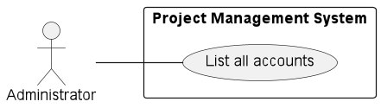
US004 : Use Case Diagram

Slide 36
US004 : Requirements Engineering
1.1 – User Story Description
As Administrator, I want to get a list of all user accounts and their status.
1.2 – Customer Specifications and Clarifications
From the specifications document:
"The system should have an administration area, which allows the Administrator to […] List all system users; Search for users with availability of at least the following fields: E-mail; Profile […].“
From the client clarifications:
Question: What’s the meaning of “status”?
Answer: The user can have two status: Active or Inactive.

Slide 37
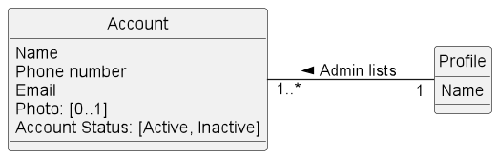
US004 : Domain Model Diagram

Slide 38
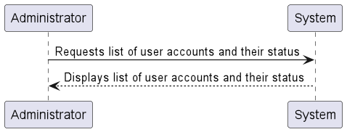
US004 : System Sequence Diagram

Slide 39
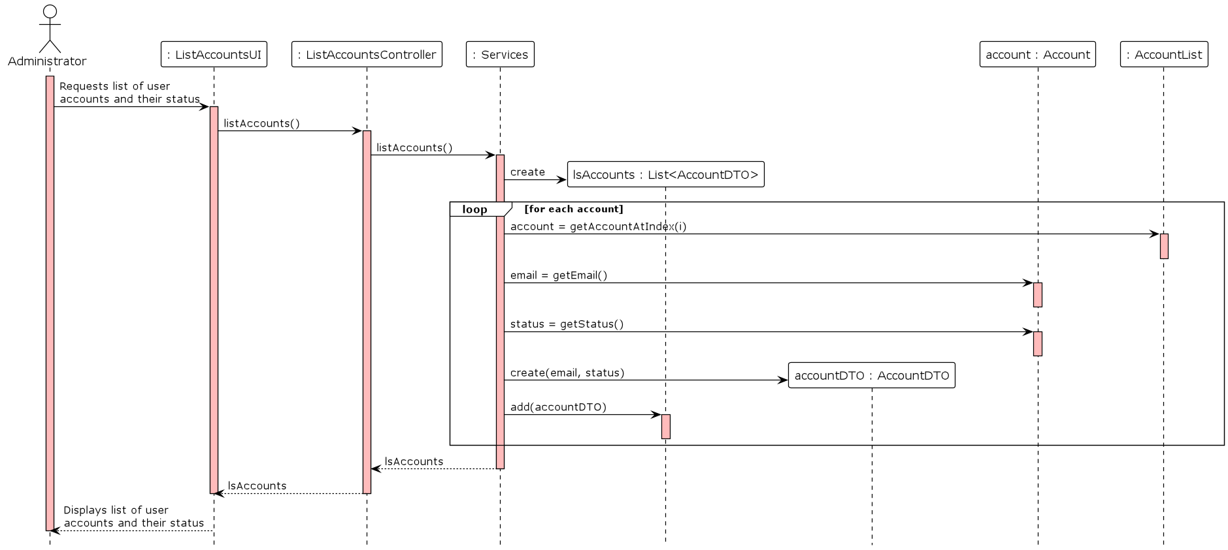
US004 : Sequence Diagram

Slide 40
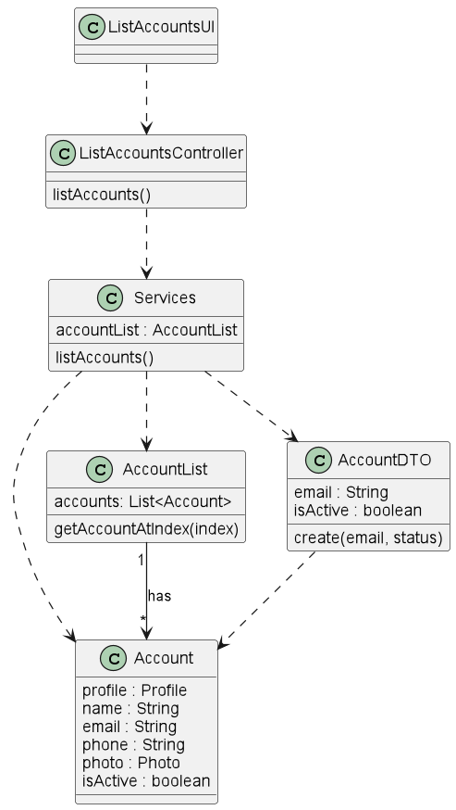
US004 : Class Diagram

Slide 41
User Story 5
As Administrator,
I want to inactivate a user account

Slide 42
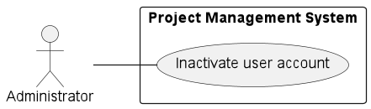
US005 : Use Case Diagram

Slide 43
US005 : Requirements Engineering
1.1 – User Story Description
As Administrator, I want to inactivate a user account.
1.2 – Customer Specifications and Clarifications
From the specifications document:
"The system should have an administration area, which allows the Administrator to […] Activate and disable user accounts […].“
From the client clarifications:
Question: Which “privileges” are withdrawn from an inactive user account?
Question: In case of more than one administrator, can an administrator inactivate another administrator?

Slide 44
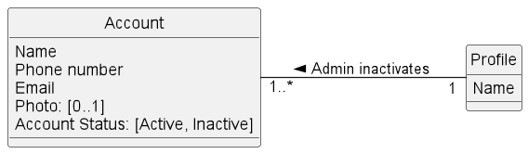
US005 : Domain Model Diagram

Slide 45
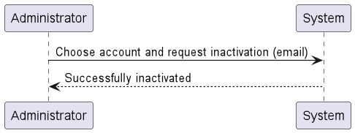
US005 : System Sequence Diagram

Slide 46
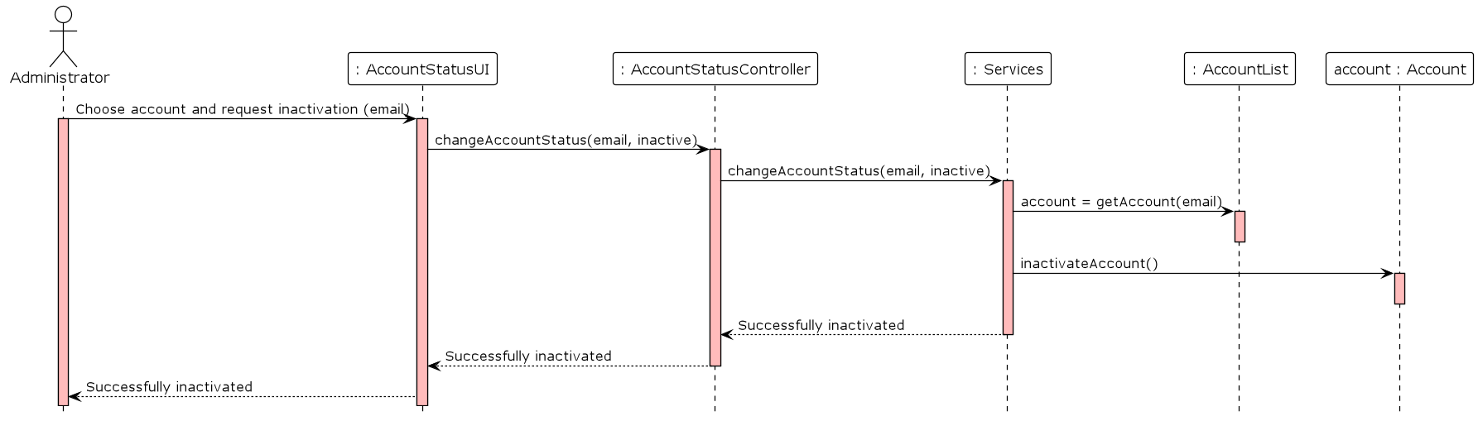
US005 : Sequence Diagram

Slide 47
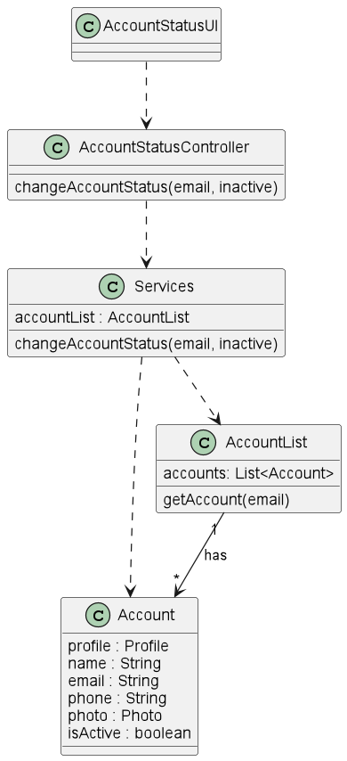
US005 : Class Diagram

Slide 48
User Story 6
As Administrator,
I want to activate a user account

Slide 49
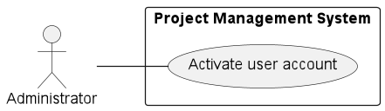
US006 : Use Case Diagram

Slide 50
US006 : Requirements Engineering
1.1 – User Story Description
As Administrator, I want to activate a user account.
1.2 – Customer Specifications and Clarifications
From the specifications document:
"The system should have an administration area, which allows the Administrator to […] Activate and disable user accounts […].“
From the client clarifications:

Slide 51
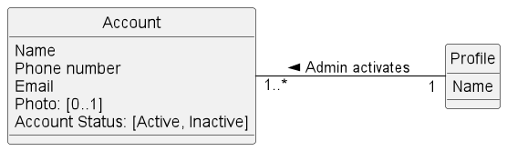
US006 : Domain Model Diagram

Slide 52
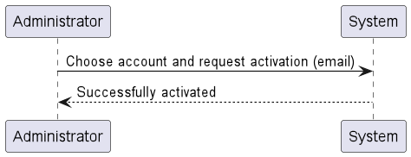
US006 : System Sequence Diagram

Slide 53
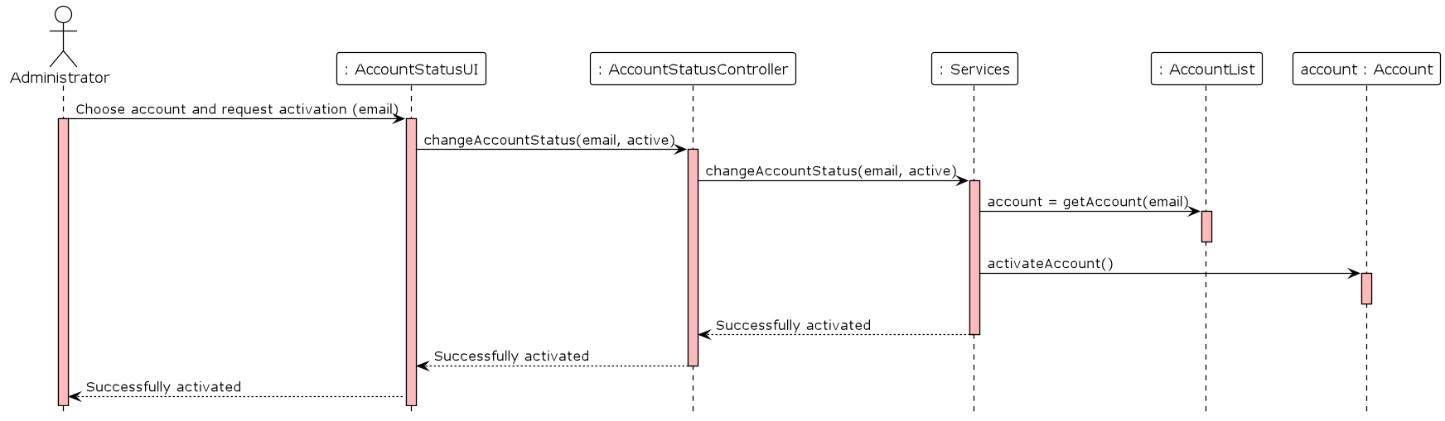
US006 : Sequence Diagram

Slide 54
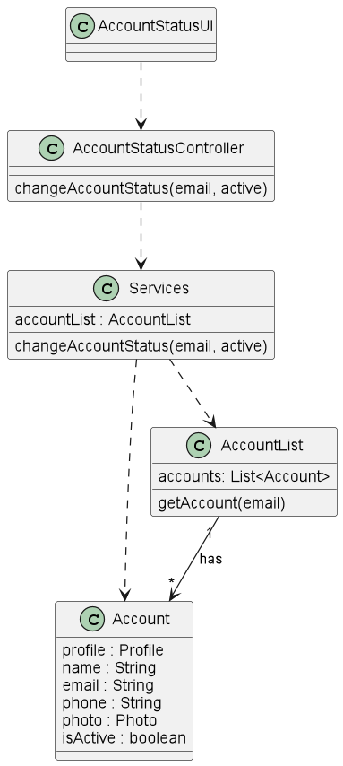
US006 : Class Diagram

Slide 55
Class Diagram

Slide 56
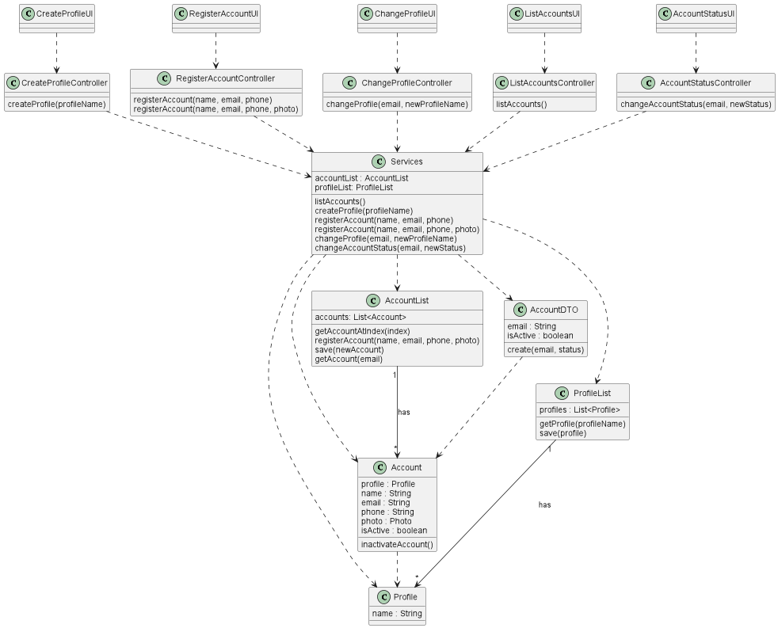

Slide 57

“God does not code, and software developers do not make miracles”
GROUP 3
André Campos
Cristina Teixeira
Deborah Oliveira
Ivo Menezes
Joana Fonseca
Marisa Graça
Pedro Silva
Ricardo Tavares
Tiago Silva

